Slide 1
WHO Information Network for Epidemics
Novel coronavirus (2019-nCoV)
2019 - 2020
Update #4 30.01.20

Slide 2
New information

Slide 3
Trends in number of total reported confirmed cases of 2019-nCoV globally
Source: WHO situation reports: https://www.who.int/emergencies/diseases/novel-coronavirus-2019/situation-reports that include information reported to WHO Geneva by 10 AM CET on the date of publication.

Slide 4
The numbers – data as of 30.01.2020 – various sources
Total number of cases
8,235
Total number of deaths
171
Total recovered
143
19 Countries affected:
China
Japan
Republic of Korea
Viet Nam
Singapore
Australia
Malaysia
Cambodia
Thailand
Nepal
Sri Lanka
United States of America
Canada
France
Germany
United Arab Emirates
India
Philippines
Finland
The most vulnerable people are those with underlying conditions and advanced age.
Source: https://gisanddata.maps.arcgis.com/apps/opsdashboard/index.html#/bda7594740fd40299423467b48e9ecf6
Not all confirmed cases are verified – data sources for the website are WHO, CDC, NHC and Dingxiangyuan.
Please also see WHO situation reports: https://www.who.int/emergencies/diseases/novel-coronavirus-2019/situation-reports that include information reported to WHO Geneva by 10 AM CET on the date of publication.

Slide 5
WHO’s risk assessment
Current WHO risk assessment: very high in China, high at the regional level and high at the global level
WHO Risk Assessments are based on:
1. Likelihood of spread
2. Potential impact to human health
3. Likelihood of insufficient control capacities
The Director-General of WHO, Dr Tedros Adhanom Ghebreyesus, met President Xi Jinping of the People’s Republic of China in Beijing on the 28th January, to discuss the next steps on how to manage the coronavirus outbreak.

Slide 6
WHO declares a Public Health Emergency of International Concern (PHEIC) – 30.01.2020
What happens when a PHEIC is declared?
What are the implications?
WHO DG issues temporary recommendations for countries to implement including:
Measures to stop international spread of the disease including increasing transparency and collaboration, and supporting countries with weaker health systems
Obligations for countries to provide sufficient public health rationale and justification to WHO about any additional measures (beyond what WHO recommends) and/or travel and trade restrictions
Advice to accelerate research and development of vaccines, therapeutics and diagnostics
Some countries may use the declaration of a PHEIC as a trigger for certain policies and procedures to be implemented
Some donors may use the declaration of a PHEIC as a trigger for releasing funding for response
https://www.who.int/news-room/detail/30-01-2020-statement-on-the-second-meeting-of-the-international-health-regulations-(2005)-emergency-committee-regarding-the-outbreak-of-novel-coronavirus-(2019-ncov)

Slide 7
Information about the virus and the outbreak

Slide 8
Introduction
What is a coronavirus?
Coronaviruses are a group of viruses belonging to the family of Coronaviridae, that infect both animals and humans. Human coronaviruses can cause mild disease similar to a common cold, while others cause more severe disease (such as MERS - Middle East Respiratory Syndrome and SARS – Severe Acute Respiratory Syndrome). Some coronaviruses that are found in animals can infect humans – these are known as zoonotic diseases.
How are coronaviruses spread?
Human coronaviruses are usually spread through droplets (coughing) and close personal unprotected contact with an infected person (touching, shaking hands).
What are the symptoms?
Signs and symptoms are typically respiratory symptoms and include fever, cough, shortness of breath, and other cold-like symptoms.

Slide 9
Introduction continued
What is known about the disease identified in Wuhan China?
It is caused by a novel coronavirus (called 2019-nCoV)
Infection with this virus causes respiratory disease ranging from mild to severe disease.
Some infected patients have died (elderly people and people with serious underlying medical conditions are more at risk for severe disease and death)
What is NOT known about the disease?
Where it came from?
How easily it spreads between people?
Who is vulnerable to infection?

Slide 10
Human to human transmission
It is evident that some human to human transmission is occurring between close contacts including family members and health care workers. The full extent of this transmission is not yet known.

Slide 11
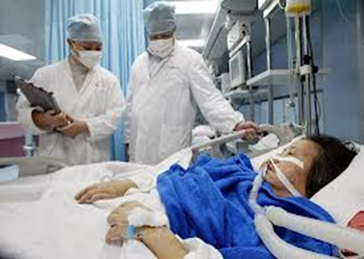
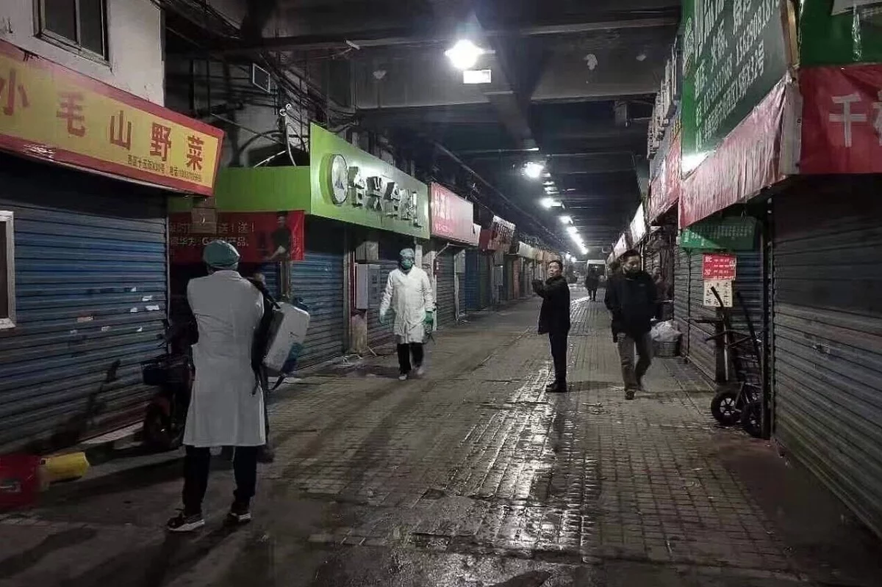
What is being done to control the outbreak?
What are affected countries doing?
Remaining vigilant for new cases and providing care for existing cases
Implementing screening of travelers
Sharing information with WHO and other countries
What is WHO doing?
Increasing understanding of this disease
Providing advice
Keeping countries informed
Coordinating with partners
Helping countries prepare

Slide 12
Priorities for collective action to stop transmission and mitigate the impact of the event
1
Limit human to human transmission
2
Identify, isolate and care for patients early
3
Address critical unknowns (source, clinical severity, extent of transmission and infection, treatment options, diagnostics therapeutics and vaccines)
4
Communicate critical risk and event information to all communities and countering misinformation
5
Minimize social and economic impact through multisectoral partnerships

Slide 13
Guidance and advice

Slide 14
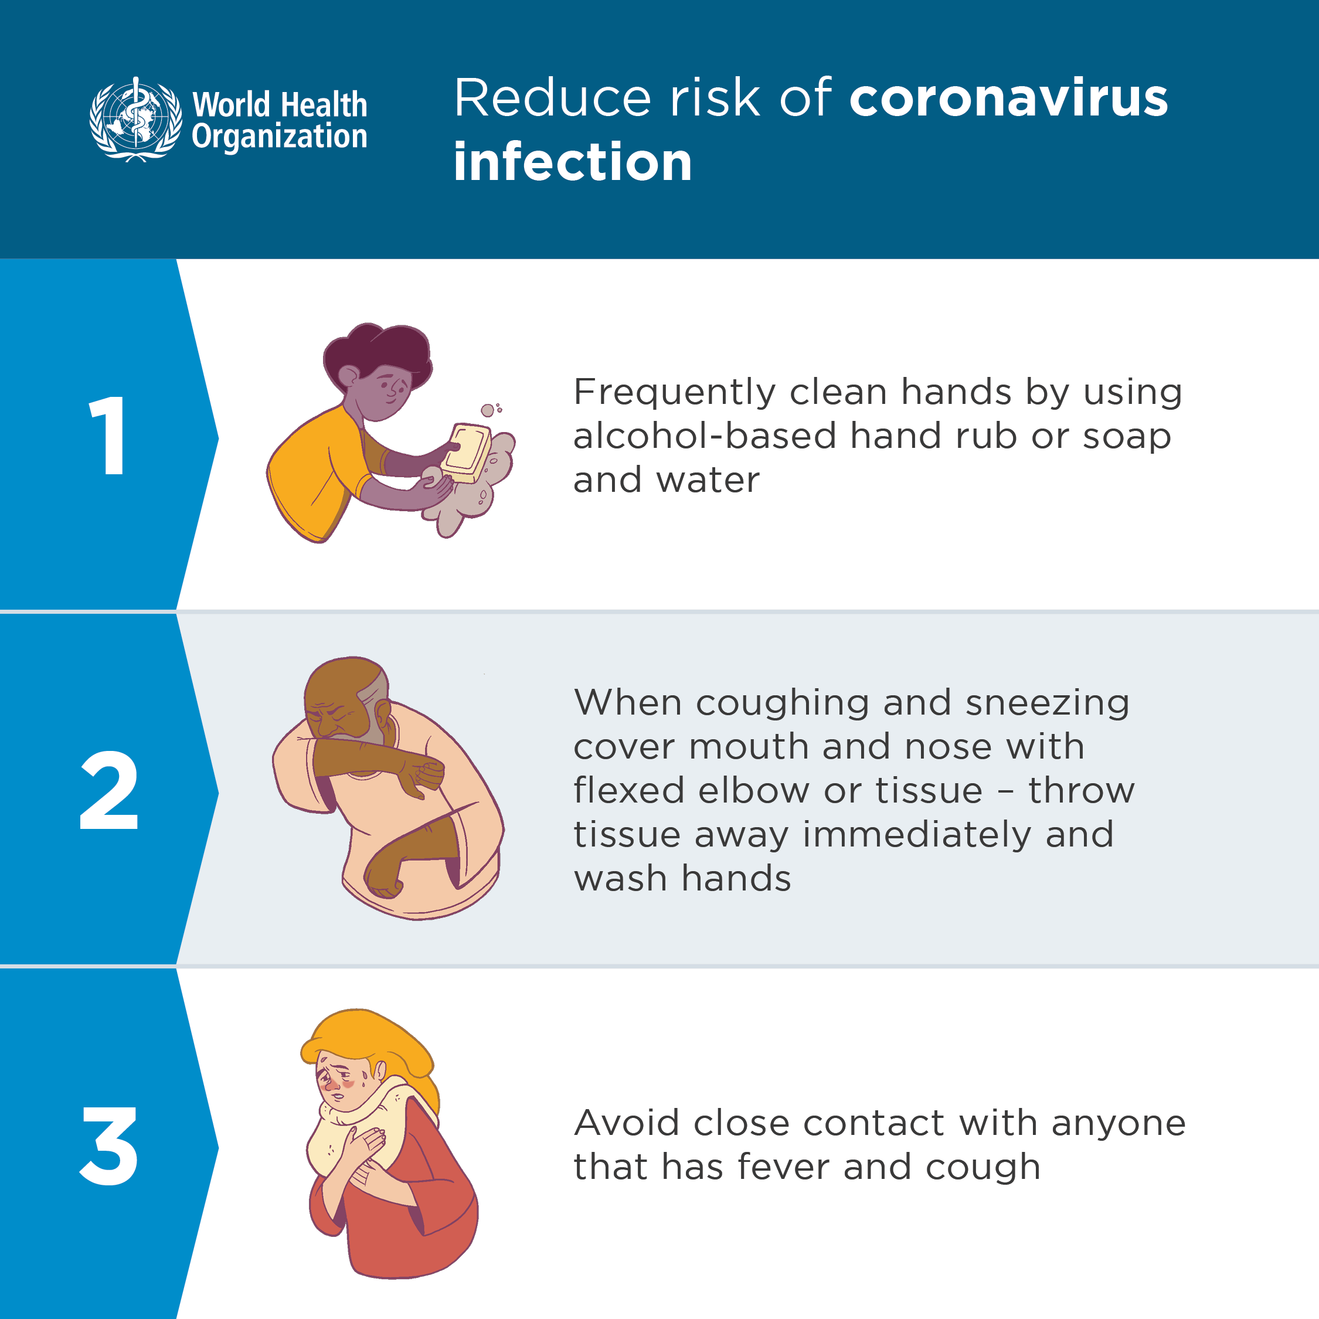
Public health advice
Stay healthy and protect yourself and others from infection

Slide 15
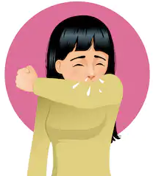
Advice for people living in an area of China that has been affected or traveled from an affected area
Stay aware of the latest information and take care of your health by doing the following:
Maintain social distancing – maintain 1 – 2 meters distance between yourself and other people, particularly those that are coughing, sneezing and have a fever
Why? When someone sneezes or coughs, small droplets carrying the virus can project resulting in one becoming contaminated with the person’s secretions if a certain distance isn’t maintained
Avoid touching eyes, nose and mouth
Why? Hands touch many surfaces which can be contaminated with the virus. If you touch your eyes, nose or mouth with your contaminated hands, you can transfer the virus from the surface to yourself.
Wash your hands frequently with alcohol-based hand rub or soap and water
Why? Washing your hands with alcohol-based hand rub or soap and water kills the virus if it is on your hands.
If you have fever, cough and difficulty breathing seek medical care early and share previous travel history with your health care provider
Why? Whenever you have fever, cough and difficulty breathing it’s important to seek medical attention promptly as this may be due to nCoV or other serious condition.

Slide 16
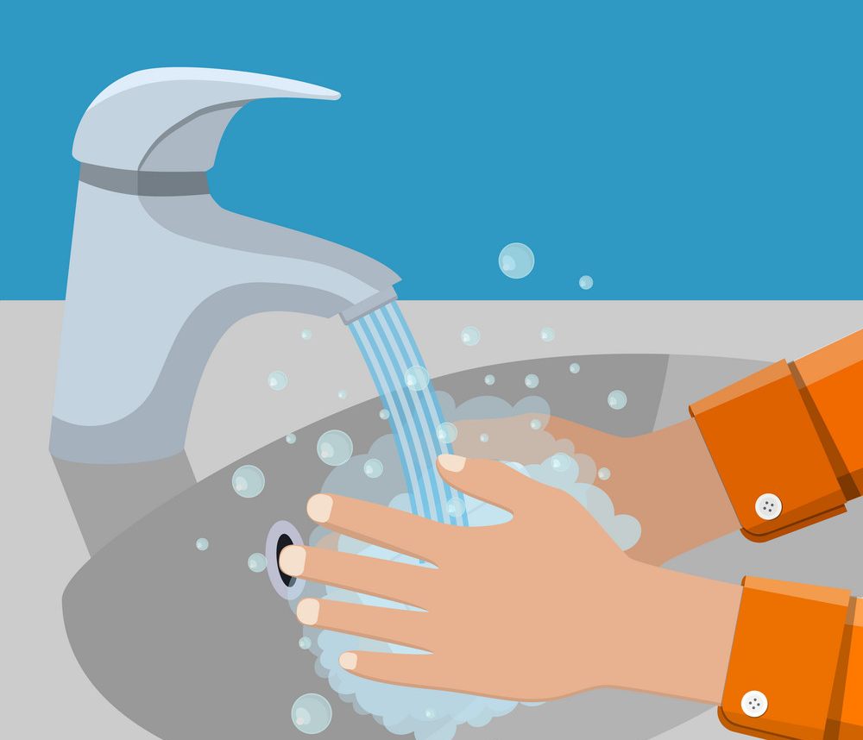
Advice for people who have not lived or visited areas that have been affected in China and have not come into contact with anyone who has been affected
Stay aware of the latest information and simply take care of your health by doing the following:
Eating a balanced diet, getting enough sleep and take the usual precautions that you would to avoid the flu
Avoid touching eyes, nose and mouth
Why? Hands touch many surfaces which can be contaminated with the virus. If you touch your eyes, nose or mouth with your contaminated hands, you can transfer the virus from the surface to yourself.
Wash your hands regularly with alcohol-based hand rub or soap and water
Why? Washing your hands with alcohol-based hand rub or soap and water kills the virus if it is on your hands.

Slide 17
Advice for travel by air, boat and train
Before you depart:
Avoid travel if you have a fever and cough
If you have a fever, cough and difficulty breathing seek medical attention and share previous travel history with your health care provider
During travel:
Avoid close contact with anyone that has a fever and cough
Frequently clean hands by using alcohol-based hand rub or soap and water
Avoid touching eyes, nose or mouth
When coughing and sneezing cover mouth and nose with flexed elbow or tissue – throw tissue away immediately and wash hands
If you choose to wear a facemask, be sure to cover mouth AND nose. Avoid touching the mask once it’s on, immediately discard single-use mask after each use and wash hands after removing masks
If you feel sick or you see somebody sick on board an aircraft, inform plane crew
If you have signs and symptoms suggestive of acute respiratory illness such as fever, cough and difficulty breathing during and after travel, seek medical care early and share previous travel history with your health care provider.
Avoid spitting.
Eat only well-cooked food. Travelers may carry their own food during travel and transit
Avoid close contact and travel with animals that are sick.
Stay healthy while travelling

Slide 18
More information
WHO sources:
NCoV website https://www.who.int/health-topics/coronavirus
Disease Outbreak News https://www.who.int/csr/don/en/
WHO Travel Advice https://www.who.int/ith/en/
Email: EPI-WIN@who.int

